Slide 1
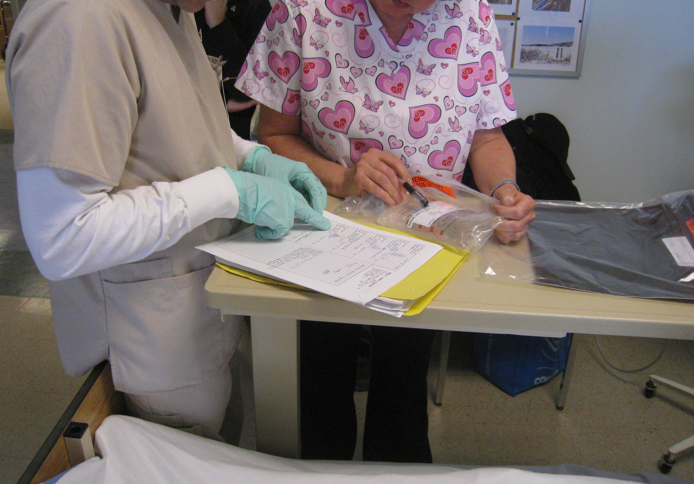
Improving the Safety of Ambulatory IV Chemotherapy in Canada
Rachel White, M.A.
Healthcare Technology Safety Research Team
University Health Network, Toronto
June 24th, 2011
ACOG Conference
Charlottetown
Notes:
ESTHER
Thank you Erin for the introduction and your kind comments. Karen, Rachel and I appreciate the opportunity provided by your committee to present this distinguished lecture this year. Thank you to CANO, its board and members for your support and acknowledgement. We want to thank Merck for their generous support of the Lecture and for being present with us today.
We are here to tell a story….the story began four years ago here in Edmonton. The circumstances, the openness and the courage of the nurses at the Cross allowed us as a research team to ask some questions and look for ways that the cancer system can be improved. We are grateful to nurses not only here in Edmonton but across the country who contributed to the study. The questions we generated for the study and the methods we used led us, as a team together, to uncover other issues. Karen, Rachel and I are here to share these findings with you; and we are sharing these in advance of the actual report release because we believed and the other members of the research team supported the fact that oncology nurses in Canada need to know the findings.
It is our hope that you will be empowered by the presentation to take home some strategies for change in your practice setting. The purpose of our presentation is to invigorate you and enable you to practice safely…for patients and for yourselves. This study could not have been done if it were not for the support from CANO and nurses at the field sites who shared their experiences and helped the team to understand the many issues that confront us in systemic therapy. This was a great example of the Power of Together!

Slide 2
Disclosure
Nothing to disclose

Slide 3

We cannot change the human condition,
but we can change the conditions under which humans work
James Reason
Notes:
This is the approach we take to safety.

Slide 4
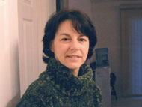
Notes:
Denise Melanson
43 year old teaching aid from Rainbow Lake, AB
Being treated at the Cross Cancer Institute in Edmonton for nasopharyngeal cancer.
As you all know, Denise died tragically in August 2006 when a nurse accidentally programmed her ambulatory infusion pump to infuse her 5FU in 4 hours instead of 4 days.
Secondary victims: staff
This could have happened anywhere to any one of us
Another incident actually happened prior to this death, that was disclosed as a result of this one being brought forward
It happened here in Edmonton, and the staff here have been devastated
Tremendous leadership shown by the hospital. It is thanks to them that we are here today and can tell you about the wonderful things that have resulted from the response to this tragedy.

Slide 5
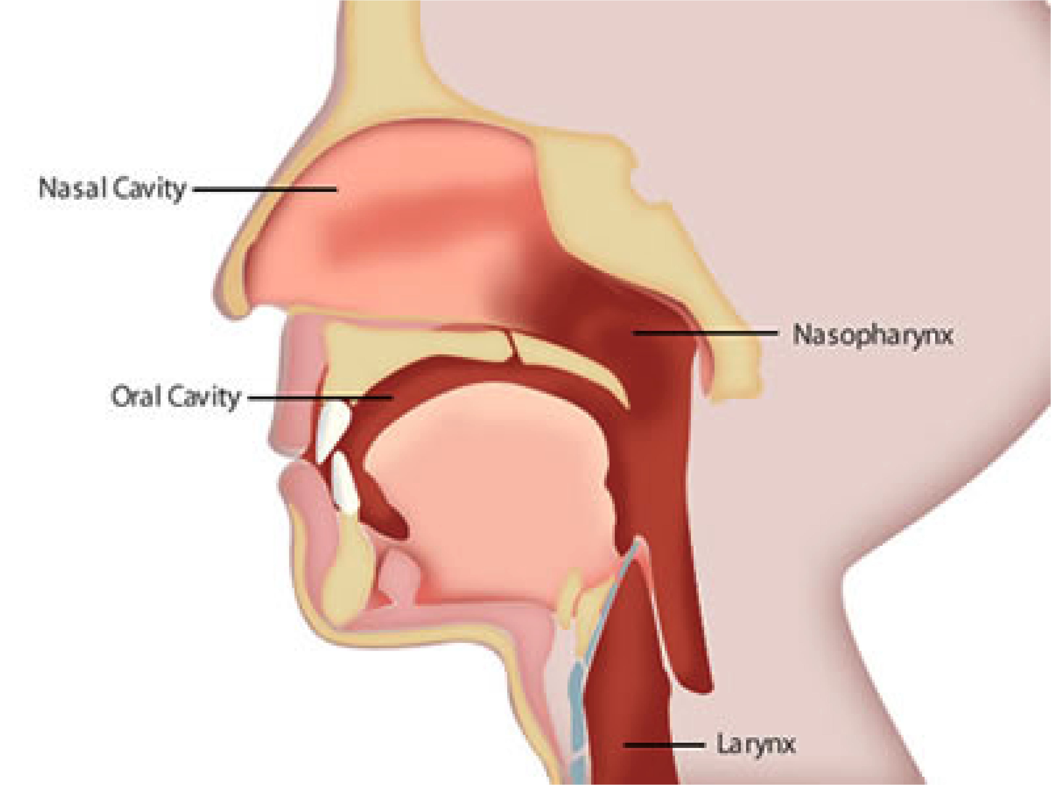
Notes:
She was diagnosed with advanced nasopharyngeal cancer (nasopharynx is the area where the nose meets the throat).
She was scheduled to receive chemotherapy treatment and the treatment was expected to be effective.

Slide 6
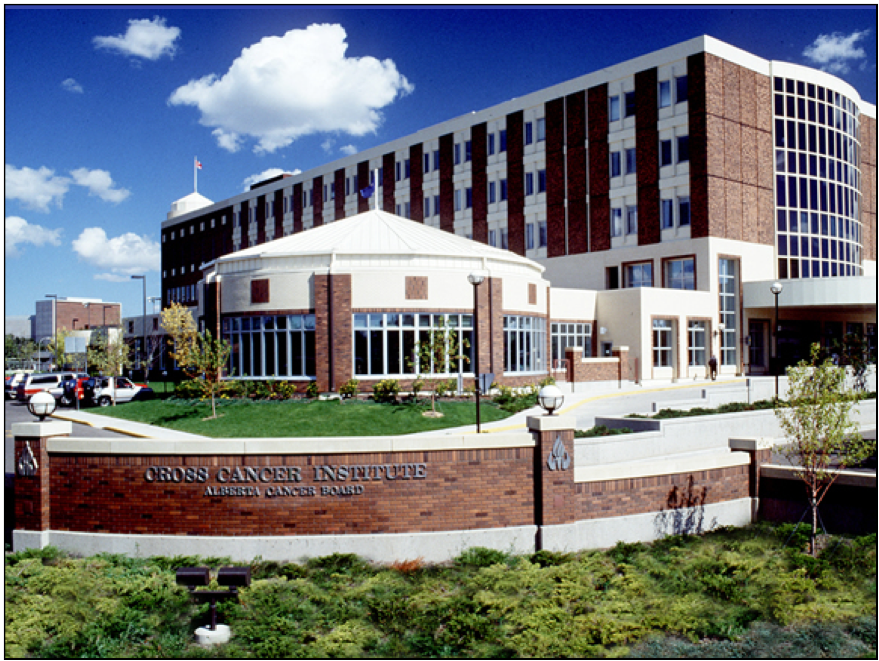
Notes:
Denise received her treatment at the Cross Cancer Institute in Edmonton.
For the duration of her treatment, she and a friend were residing at Compassion House, a supportive home away from home for cancer patients and their families.
On the morning of July 31st, 2006, Denise returned to the Medical Day Unit at the Cross for her second round of outpatient chemotherapy treatment.

Slide 7
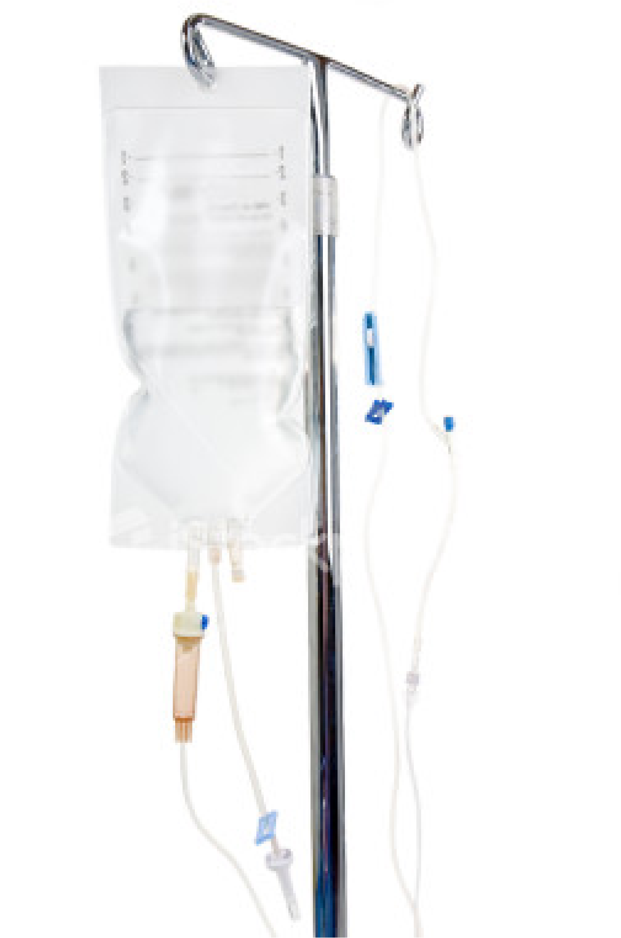
Notes:
At 9:30, she was given several IV “premedications.”
These are used to prevent the side effects of the chemotherapy.
Then she was given a chemotherapy drug, cisplatin, and finally, post-hydration.
All of this was part of the chemotherapy protocol.
It took over 5 hours to complete the treatment.

Slide 8
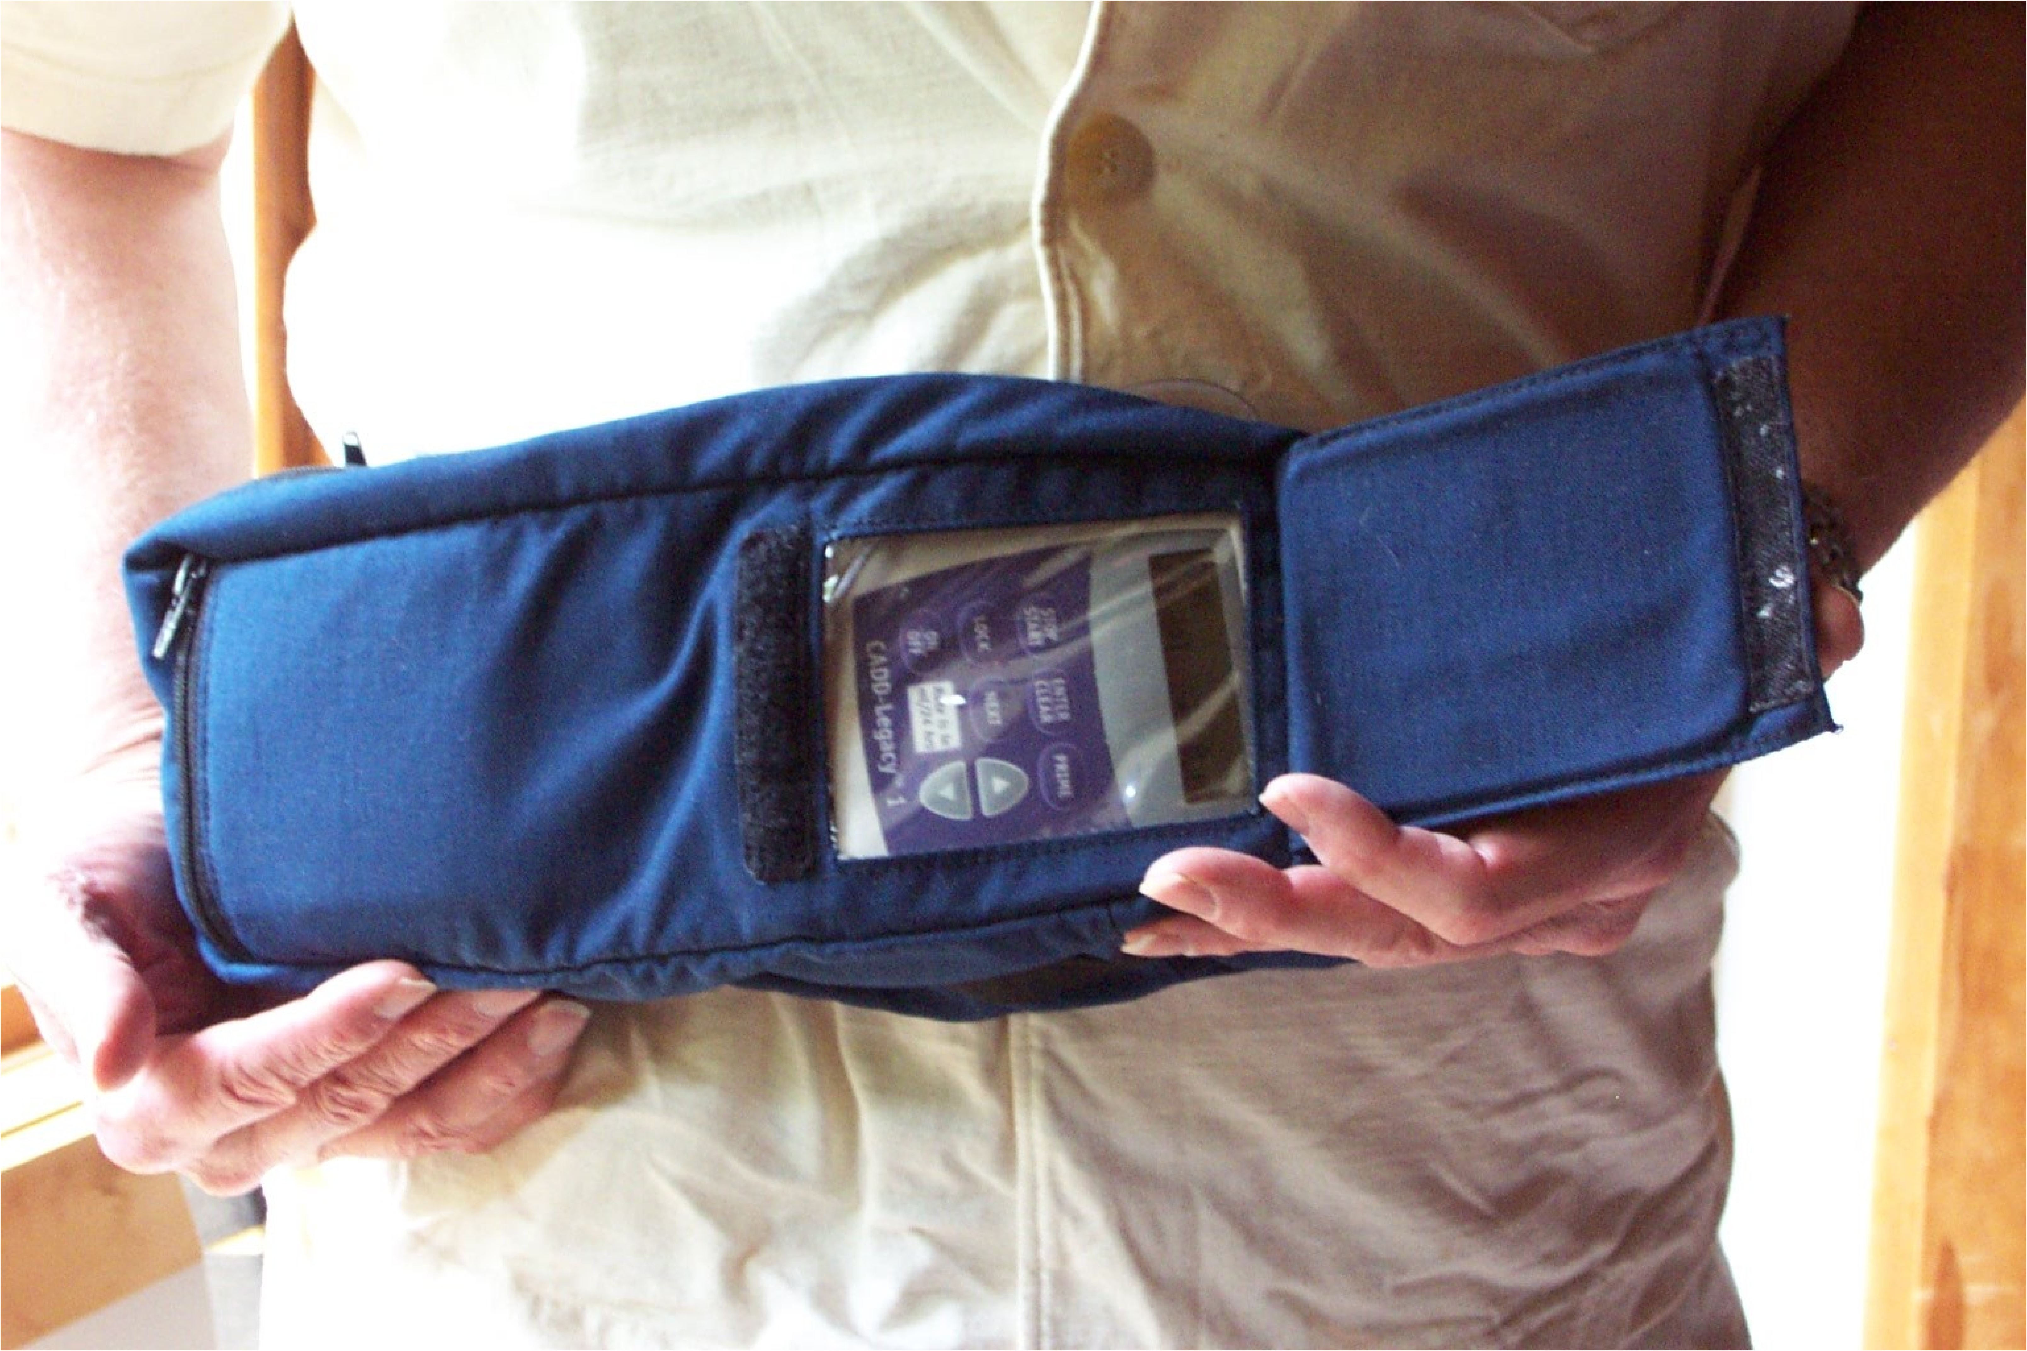
Notes:
The final part of her chemotherapy regimen was a drug called fluorouracil. This medication was to be given over a period of 4 DAYS. Thanks to advances in technology, Denise would be allowed to go home and carry on with her usual activities as the drug infused via a pump she would carry in a small “fanny pack” around her waist.
Denise’s nurse prepared the medication and programmed the infusion pump. She asked a second nurse to check her calculations and pump programming before initiating the infusion. After this, the nurse reviewed the pump functionality with Denise and she was instructed to return at the end of the infusion in 4 DAYS and the pump would be disconnected. At approximately 2:30pm, Denise left the clinic and returned to Compassion House with her friend.
However, 4 HOURS later, Denise noticed that the pump was beeping, and when she opened the fanny pack she saw that the fluorouracil bag was empty.
A volunteer at Compassion House immediately drove Denise and her companion back to the hospital. Denise was told there was nothing that could be done to reverse the overdose, so they returned to Compassion House and were told to call the unit the next day.

Slide 9

CTV Video
Notes:
Denise Melanson CTV Video

Slide 10
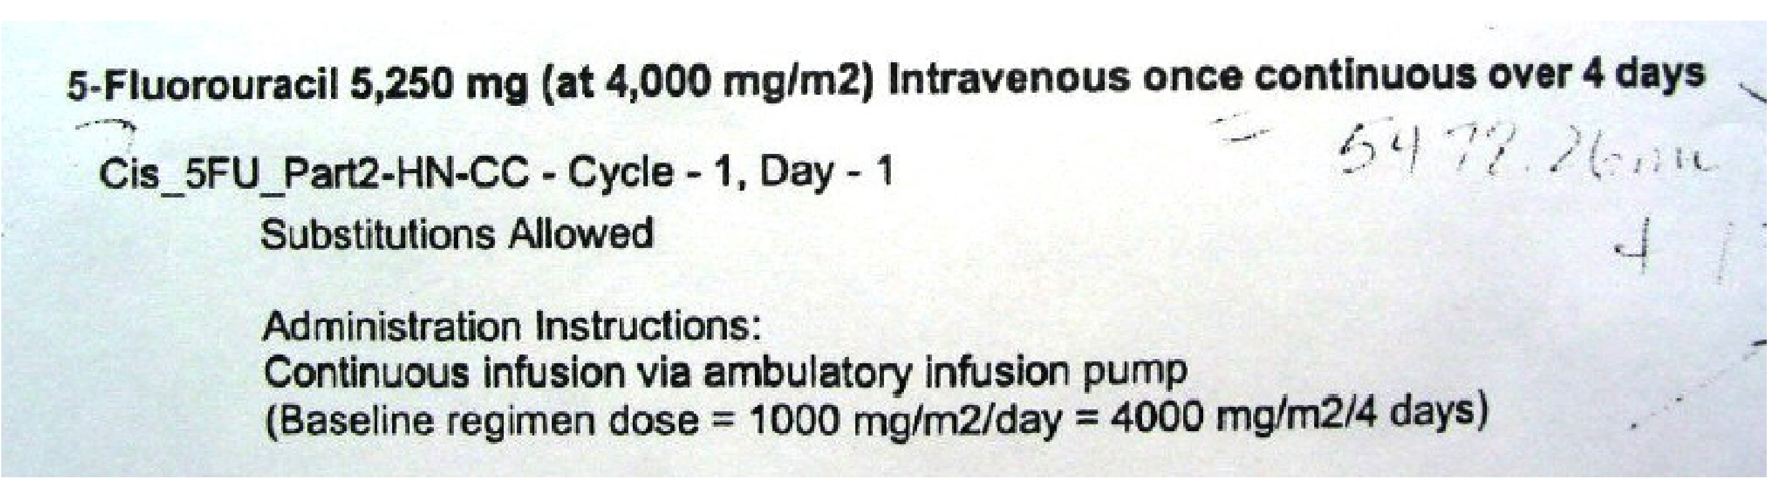
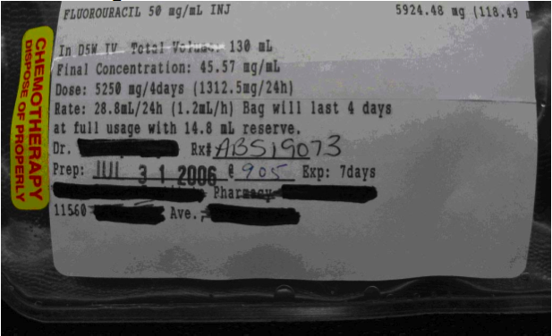
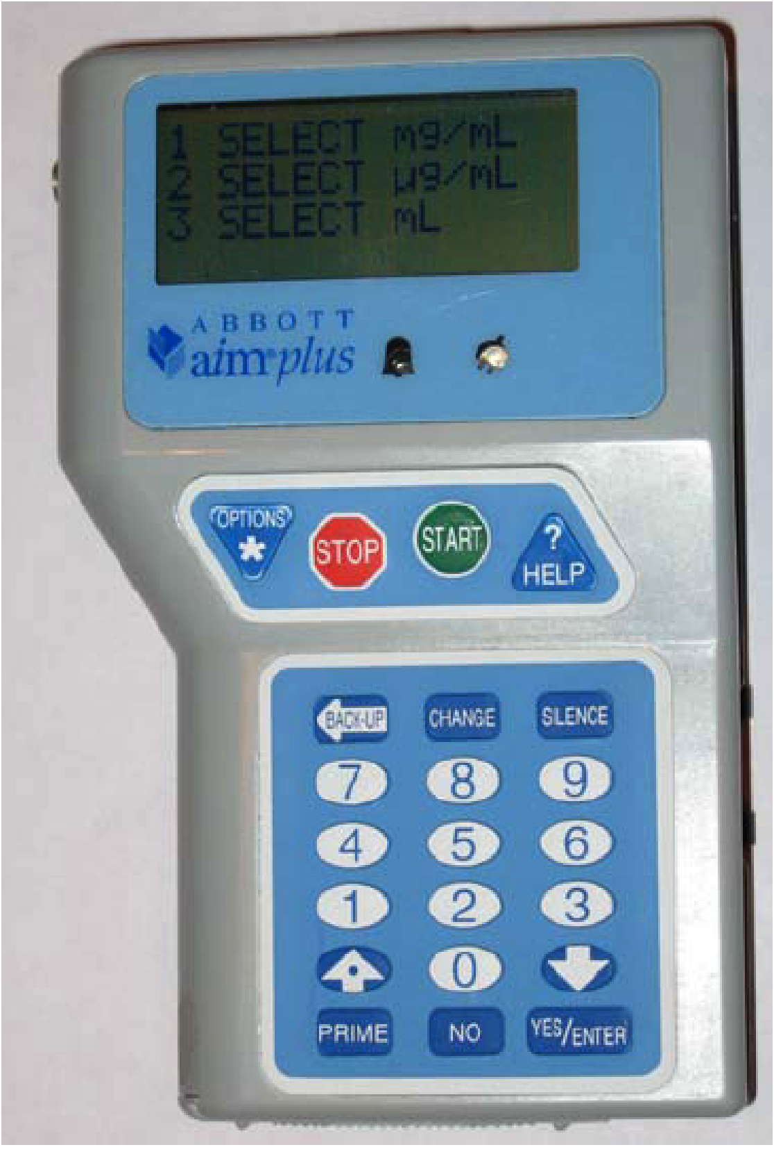

Notes:
The doctor’s order, the drug label, the pump and the process of the double check to verify the correct calculation was completed.
Following the incident, the Institute for Safe Medication Practices (ISMP) Canada conducted an investigation of the events leading up to Denise’s death. The investigation uncovered several contributing factors: the design of The medication order, the design of the drug label, the design of the pump and the way the double check was performed

Slide 11
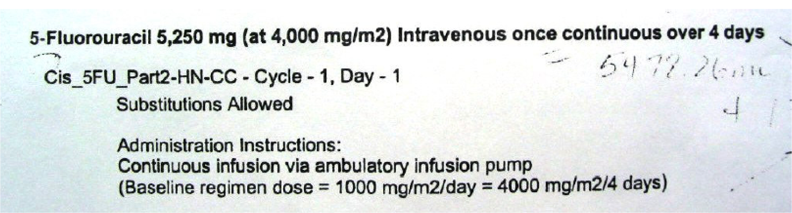
Medication Order
Notes:
Let’s take a closer look at the actual order:
This is a picture of the medication order prepared by Denise’s oncologist.
(NEXT) The order shows that 5250mg of 5-Fluorouracil should be infused based on the BSA of 4000mg/m2. (NEXT) The order shows that the infusion should occur continuous over 4 days.
On the bottom of the order, there is some information about the regimen, followed by Administration Instructions, again, stating a continuous infusion via ambulatory infusion pump. And also specifying the baseline regimen dose.

Slide 12
Drug Label
Notes:
This is the drug label printed by pharmacy.
(NEXT) It includes the name of the drug, (NEXT) the total volume of the bag, the final concentration, (NEXT) the dose which is the same as was lindicated on the order - specified for 4 days, and also the dose per 24 hours.
(NEXT) The rate is 28.8mL/24 hours which translates to (NEXT) 1.2 mL/hour and it is stated that the bag (NEXT) will last 4 days.
[After all, it is a 130 mL bag, and the rate for 24 hours is 28.8 mL. ( quick mental calculation and you know that 3o mL x 4 days is 120 which is less than 130)]
Then there is some administrative information below these details.
A lot of information is irrelevant to the nurses, but important to the pharmacists. As you can see, the drug label must be useful to both groups of users.

Slide 13
Calculation
Dose ordered: 5250 mg per 4 days
Pump programmed in: mL per hour
5250 mg / 4 days = 1312.5 mg per day
1312.5 mg / 24 hours = 54.6875 mg per hour
54.6875 mg per hour / 45.57 mg per mL mixed concentration from pharmacy
= 1.2 mL per hour infusion rate
28.8 mL per hour
Notes:
The nurse used the physician’s medication order and the drug label to determine the parameters used to program the pump.
This was the first time she was administering 5FU, but she knew the dose (N) was 5250 mg per 4 days and that the pump was required to be programmed in mL per hour (N).
So in order to get from the mg/4day rate to mL/hr rate, the following calculation must be performed:
Divide the dose per 4-day rate by 4 to get the dose per day rate.
Divide by 24 to get the dose per hour rate.
Divide by 45.57 (concentration in mg/mL) to get the correct rate of 1.2mL/hour.
However, the nurse who programmed Denise’s pump calculated 28.8mL/hour (N) as the infusion rate because the 2nd step of the calculation was missed (N).
A double check was done by a second nurse who verified the calculation and programming parameters. She couldn’t find a calculator so she worked out the calculation on a scrap piece of paper and confirmed the 28.8 mL/hour rate. The first nurse proceeded to program the pump with this rate.
As we know, this resulted in the 24-fold over dose that led to Denise’s death.

Slide 14

Who is to blame?
Notes:
There it is on the bag: 1.2mL/h (N)
So I’m going to ask what might be a controversial question - and that is - should the nurses in this case bear the blame for Denise’s death? 1st nurse or 2nd nurse to blame? (In case of silent audience: raise the question of professional responsibility, of the 5 rights, etc etc). There are no right or wrong answers here.
(May already be picking up on systemic issues: label, pump, processes)
At this point, I hope you are realizing that processes put in place are not always designed well. If processes were designed better, the chances of error decreases.
Now I’m going to show you a video, which may seem out of place…

Slide 15
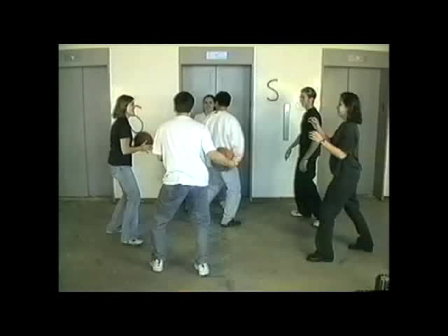
Gorilla Video
Notes:
For those who may have seen it before, please play along and keep your answers to yourself.
What I’d like you to do while you’re watching this video is keep your eye on the team wearing WHITE shirts. Count the number of passes that this team makes to each other throughout the duration of the video.

Slide 16

Attentional Blindness
Failing to see what should have been plainly visible
  Because attention is not focused on it
Attentional resources are finite
Notes:
This is our first ‘human factor’: if we’re too focused on something we might miss something that’s right there in front of us.
The 1st time you watched the video you were too busy counting passes that you didn’t see something that was very obvious when you took a step back and looked at the whole picture.
On a daily basis our sense are inundated with such a large amount of input, sights, sounds, smells, etc., that our minds cannot fully process it all. To cope with the problem, we have evolved a mechanism called attention, which acts as a filter that quickly examines sensory input and selects a small percentage for full processing and for conscious perception. The remaining information is lost, unnoticed and unremembered - we are inattentionally blind to it since it never reached consciousness.

Slide 17
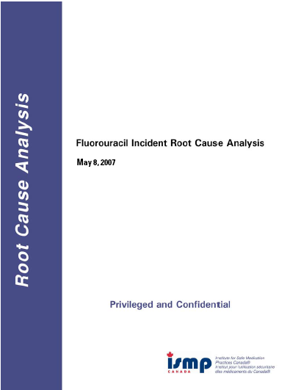

Notes:
As a result of the Cross coming forward, ISMP did an excellent review of the root causes of the sentinel event
Identified multiple factors in the complex system that led to this event
Identified that a number of other incidents had also occurred
Report focussed on factors leading to this specific event with this drug at this site.
Lots of findings relevant to the general oncology community
But it also highlighted to us that there were things we did not know…
FORMATION OF STSC

Slide 18

Research Grant
Dr. Tony Easty
Dr. Anthony Fields
Multi-disciplinary / multi-jurisdictional team
  Human factors engineering
  Pharmacy
  Nursing
  Medical oncology

Slide 19
Collaborators
Study Co-Investigators
Rachel White
Andrea Cassano-Piché
Jennifer Jeon
Debbie Chan
Roxanne Dobish
Karen Janes
Dhali Dhaliwal
Eshwar Kumar
Venetia Bourrier
Sylvia Hyland
Esther Green
Brent Schacter
Maureen Trudeau
Yoo-Joung Ko
Kim Vicente
Systemic Therapy Safety Committee
Susan Walisser
Susan O’Reilly
Denise Budz
Larry Broadfield
Heather MacKenzie
Roxanne Rodgers-Harding
Scott Edwards
Nancy Bestic
Jessica Peters
Melany Leonard
Jillian Hardy
Notes:
Oncology leaders from across Canada!
Multidisciplinary

Slide 20







Co-Sponsors
Notes:
20
Lots of support

Slide 21
Study Objectives
Identify current practices for ordering, preparing, labeling, verifying & administering ambulatory IV chemotherapy in Canada
Identify additional sources of risk in a wide variety of environments
Recommend strategies to reduce risks
Notes:
The ISMP report gave us a lot of insight into the systems issues that led directly to the 5FU incident
However, it highlighted to us that we didn’t actually have a great sense of current practice
Bullet 1
And we were concerned that there were safety issues that didn’t come to the fore as a result of the 5FU, but that were still out there.
Bullet 2
And ultimately, once we had an understanding of current practice and safety issues, we wanted to be able to…
Bullet 3
So we embarked on a multi-phased, multi-method project…

Slide 22

Phase 1: Survey
Notes:
22
Phase 1 – Survey
National survey distributed to all cancer centres in Canada via provincial agencies
Focus:
Policies and practices
Current and future safety initiatives
Tools and technologies that support safe delivery of ambulatory chemotherapy
Incidents that have occurred

Slide 23
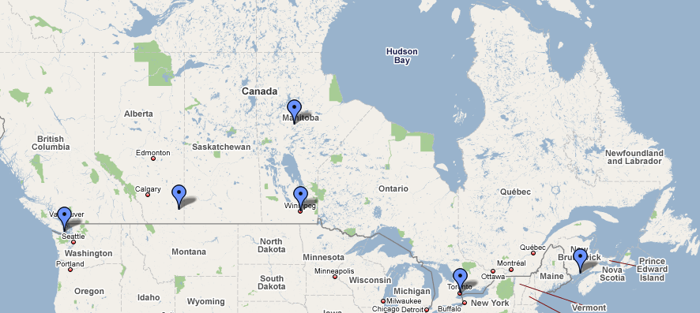
Phase 2: Field Studies
Notes:
23
Week long field studies in 6 centres across canada
Centres that would represent a broad cross-section of facility types (e.g., community, academic, rural, etc.)
2 HF specialists per visit
Shadowing Nurses, Physicians, Pharmacists, Pharmacy technicians, Clerks
Focus on systems issues, not clinical practice

Slide 24
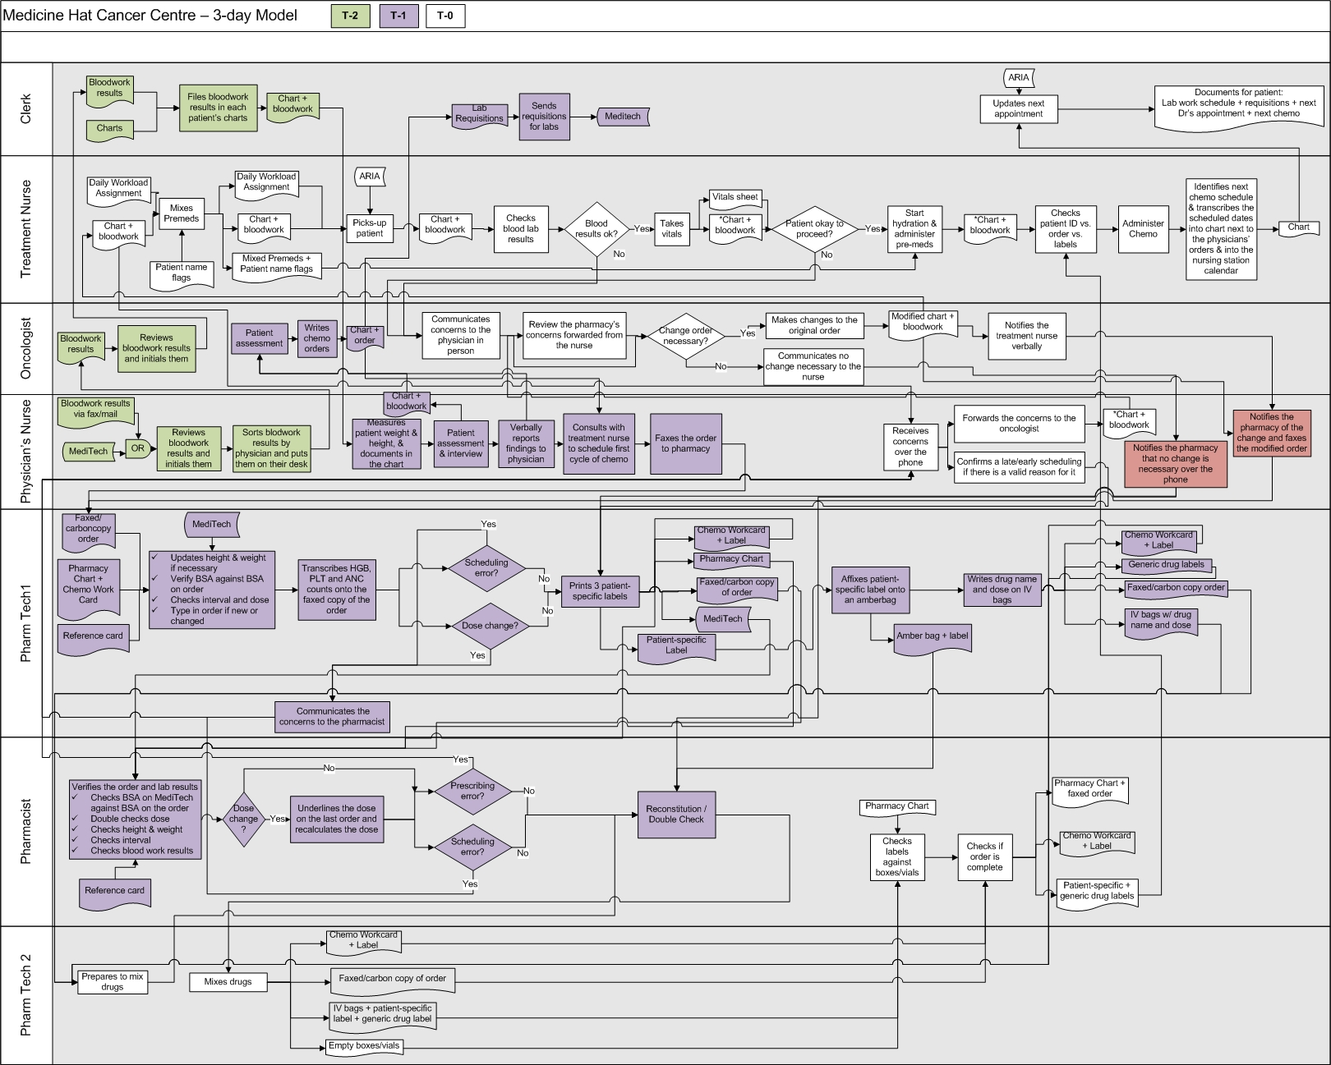
Phase 3: In depth analyses and scans
Notes:
From survey and field studies we had a massive amount of data
needed way to prioritize (don’t expect you to be able to read this)
This slide illustrates how complex the systems were and how difficult it was to make sense of all the data
Not only is each system very complex, but trying to draw conclusions across all of Canada was very challenging

Slide 25

Notes:
What did we find?

Slide 26
Safety Themes
  Elastomeric infusors
  Preprinted orders and change orders
  Mixing and checking practices
  Additional issues
Notes:
26
Based on HFMEA hazard scores of all issues identified
37 Unique issues, 11 with hazard scores over 16. These fell into the following themes
The tip of the iceberg was the programming error in Edmonton. Look at all these things that came out of digging deeper

Slide 27
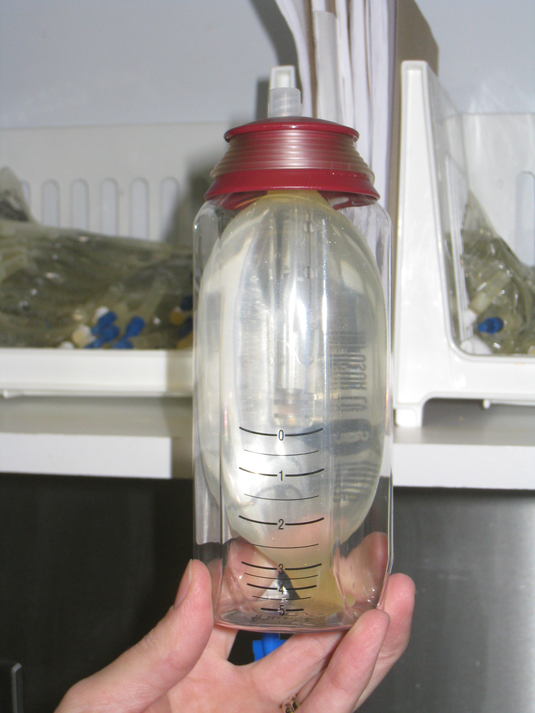
1. Elastomeric AIPs and Access Devices
Notes:
27
Elastomeric infusors = non electric fixed rate pumps AKA infusors, baby bottles
Switching to infusors a common response to 5FU incident (recommended by ISMP), but some issues emerged

Slide 28
Departure from calibration setting | Example | Rate increase
None | Physical properties of the device | +10.0%
Normal saline instead of D5W | Protocol calls for normal saline | +10.0%
Increase of 5°C above 33°C | Patient uses a heat blanket | +11.5%
Reservoir 10” above access | Device on a nightstand while patient sleeping | +5%
Total |  | +36.5%
Notes:
RACHEL
There are variables that significantly affect the performance of this device and it seems that these factors are not well known in the community
Very plausible scenarios where patient could have medication delivered almost 40% too fast.
Needed to go back to the manufacturer to figure out this information. Not readily available in the public domain.
Need better education for staff on the cumulative factors affecting flow rate. Manufacturer has been working with us on improved materials for distribution
Support the use of these pumps in principle as a forcing function in the absence of well implemented smart pumps with dose error reduction systems, but improved user-specific education required
Manufacturers need to keep working to improve their technologies

Slide 29
Notes:
RACHEL
These are fixed rate pumps so it’s very important that the correct device is filled
10 picking incidents described in survey + others described to us, E.g., 7 day infusion in 46 hours
Need to reduce the number of different models used in a centre
Also store different models separately from each other
Manufacturer needs to improve labelling and shape/colour

Slide 30
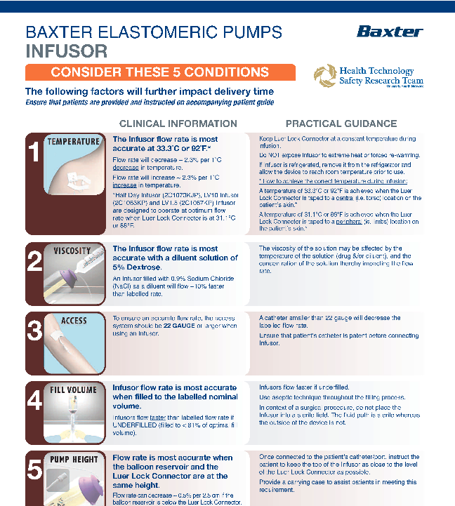
PIC OF BAXTER MATERIALS
Notes:
WE WOULD LIKE YOUR FEEDBACK THROUGH THE CANO LISTSERV> WATCH FOR IT

Slide 31
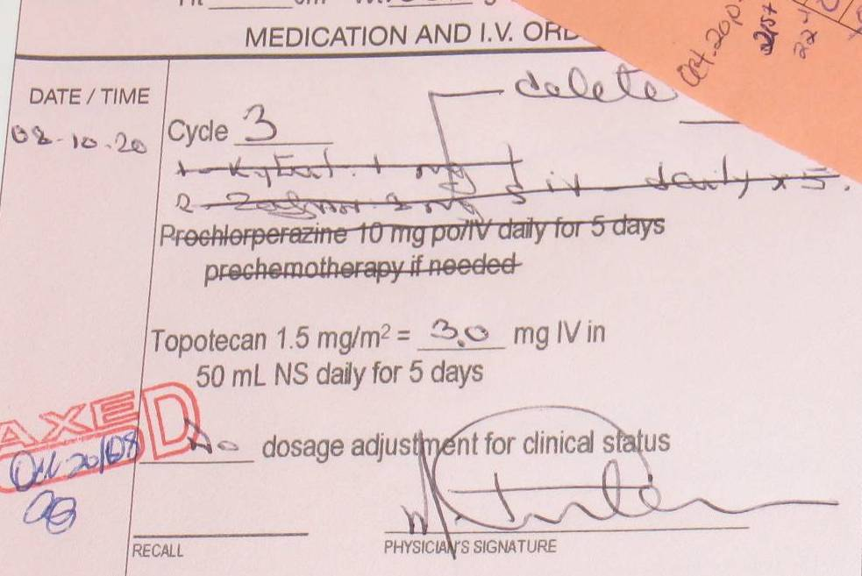
2. Orders and Labels
Notes:
PPOS are paper orders with standardized order information preprinted on them. L
From survey: 75% preprinted paper orders (PPO); 47% CPOE
Main tool for communicating change orders across disciplines
But issues with the design- information not always communicated clearly, especially changes to orders.
Issues with designs of chemotherapy labels too
31

Slide 32
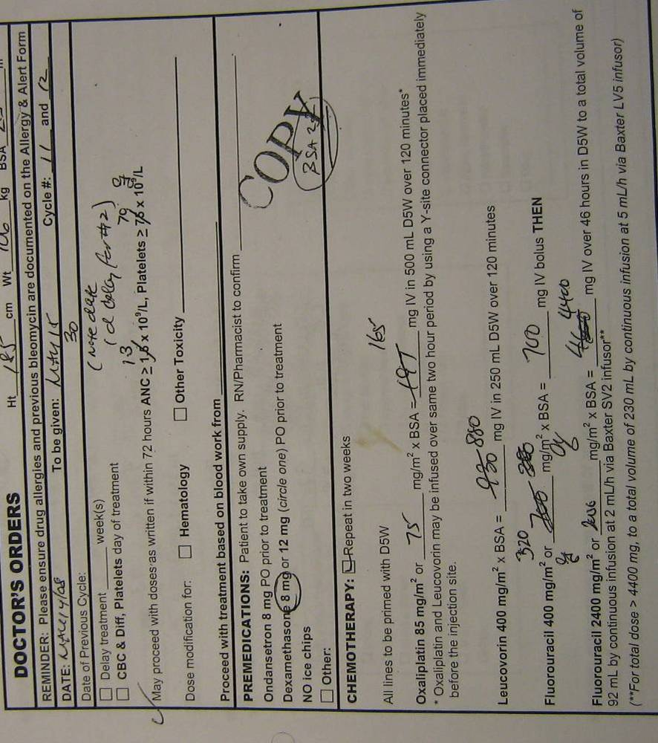
Notes:
Fluid nature of chemotherapy, Frequent dose/schedule changes
Existing preprinted orders
Not adaptable to dynamic dosing needs
Confusing format & layout
Existing PPOs do not allow making and keeping track of change orders easily.

Slide 33


Notes:
RACHEL
Embarked on a major redesign project
Inspired by NPSA and Royal College of Art
Collaboration with graphic designers, clinicians and HF specialists to generate a guideline document outlining requirements for content and design of PPOs, including electronic templates.
Detailed content and design recommendations coming soon!

Slide 34
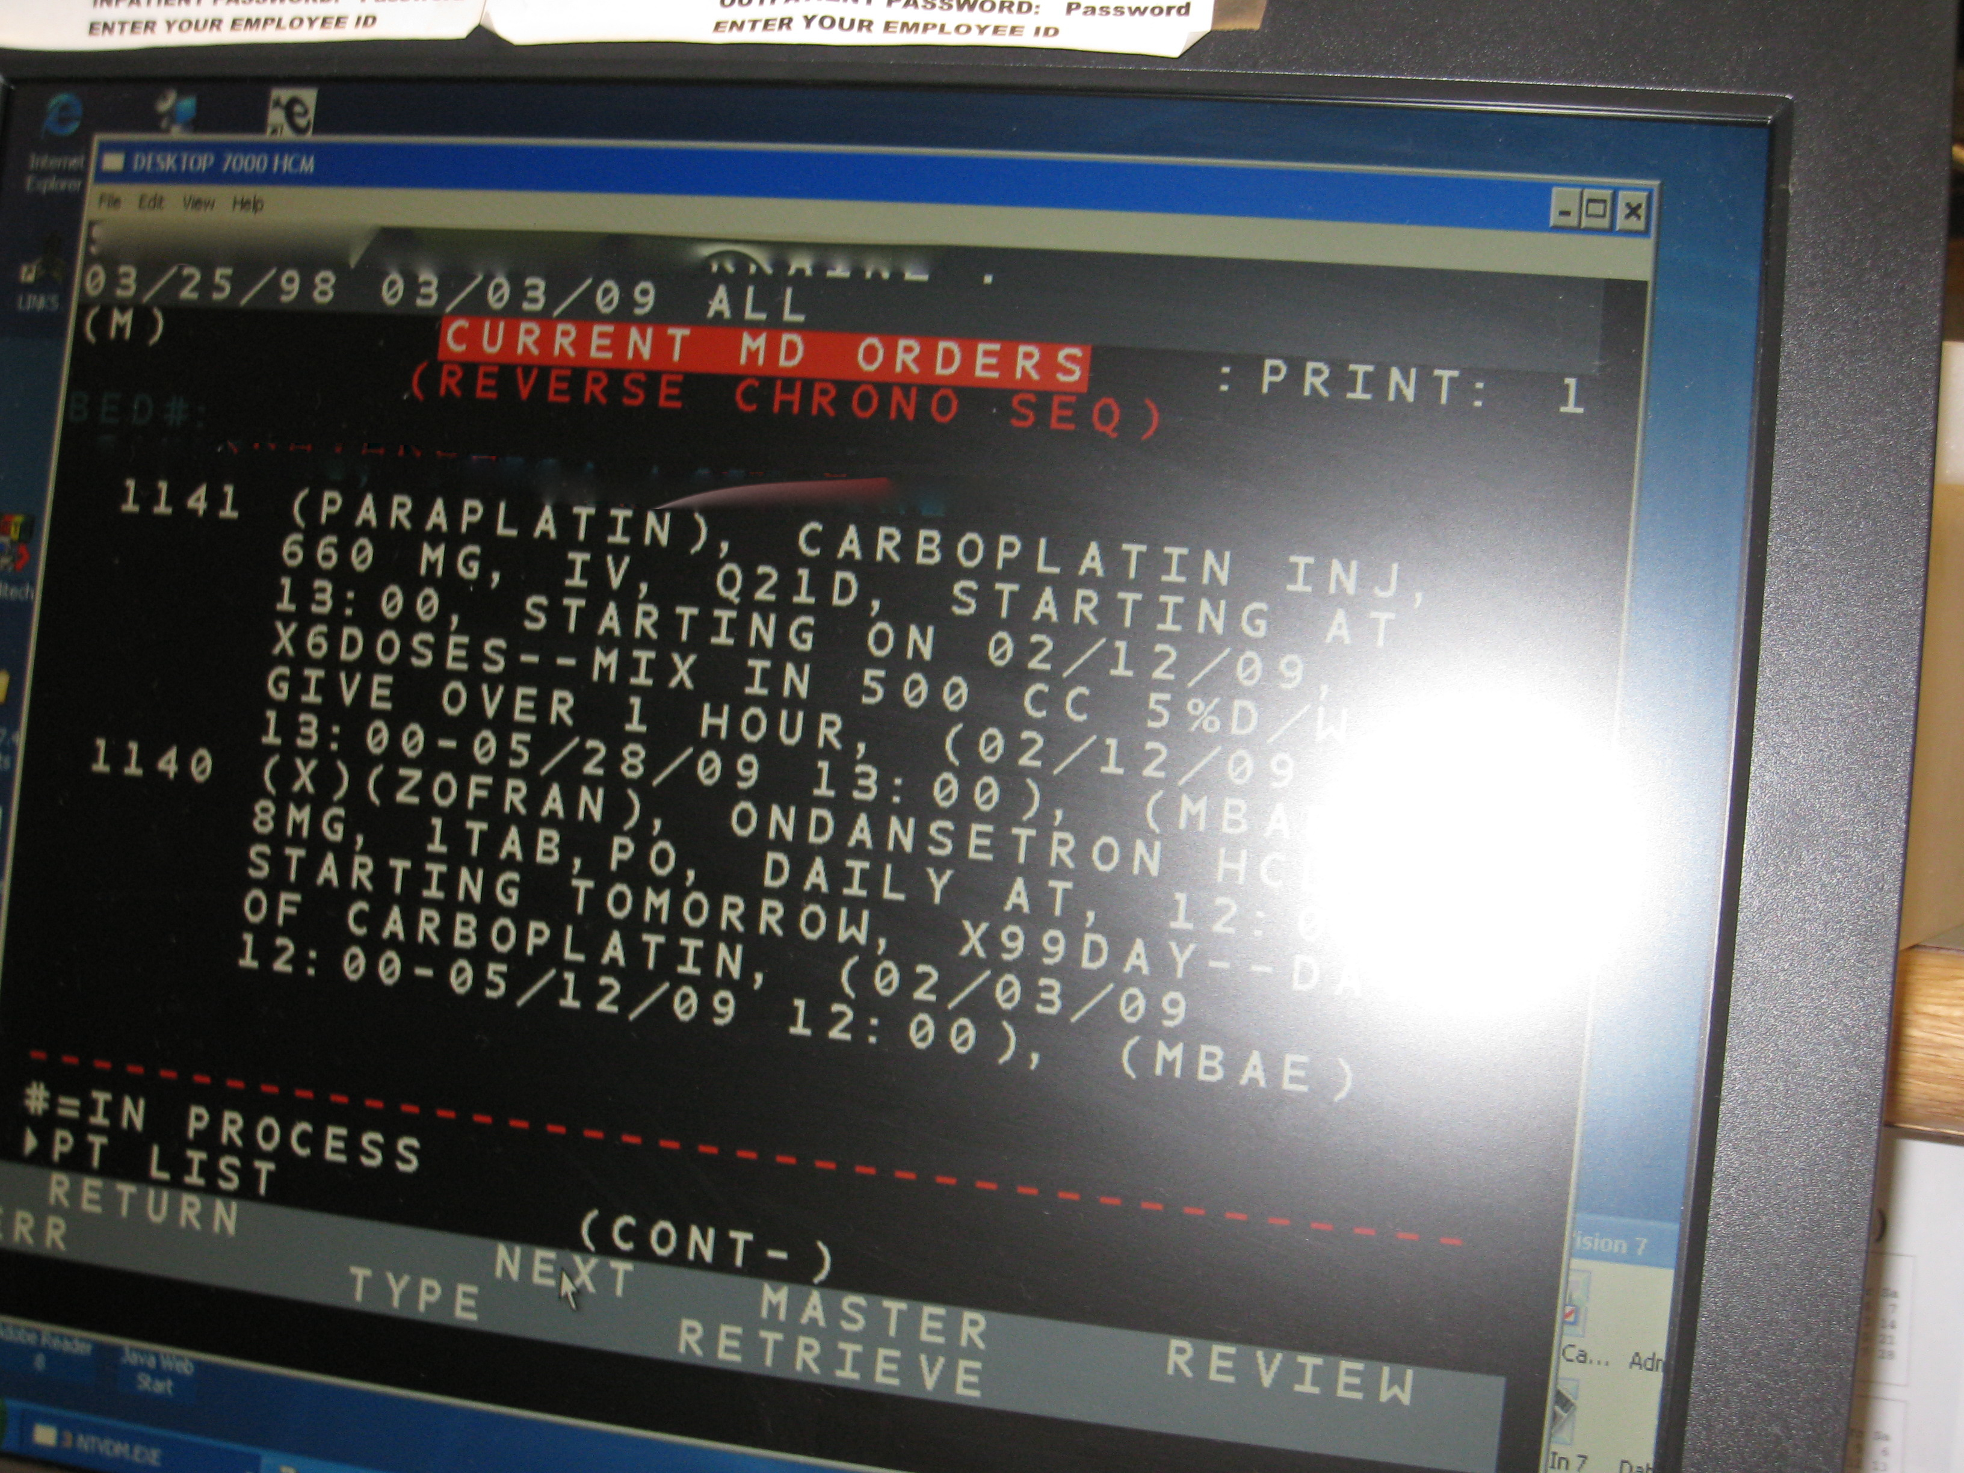
CPOE mention
Notes:
RACHEL
What about CPOE?
CPOE has the promise of improving safety and is something we are all moving towards.
Standardized PPOs will help centres without CPOE prepare for implementation.
Many CPOE systems have a long way to go.
No system is 100% safe and all systems are difficult to implement!!

Slide 35
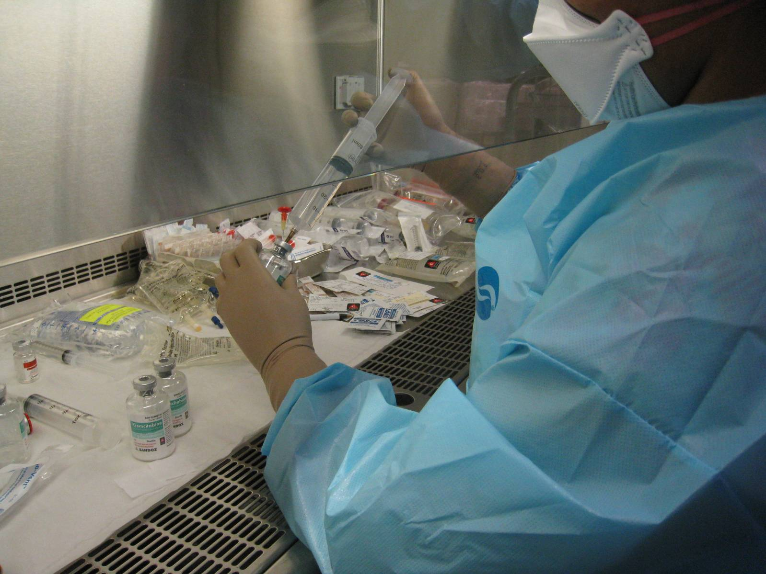
3. Mixing and checking practices
Notes:
35
Medications for a specific patient prepared by pharmacy techs in clean rooms under BSC
Unexpected set of findings around mixing safety

Slide 36
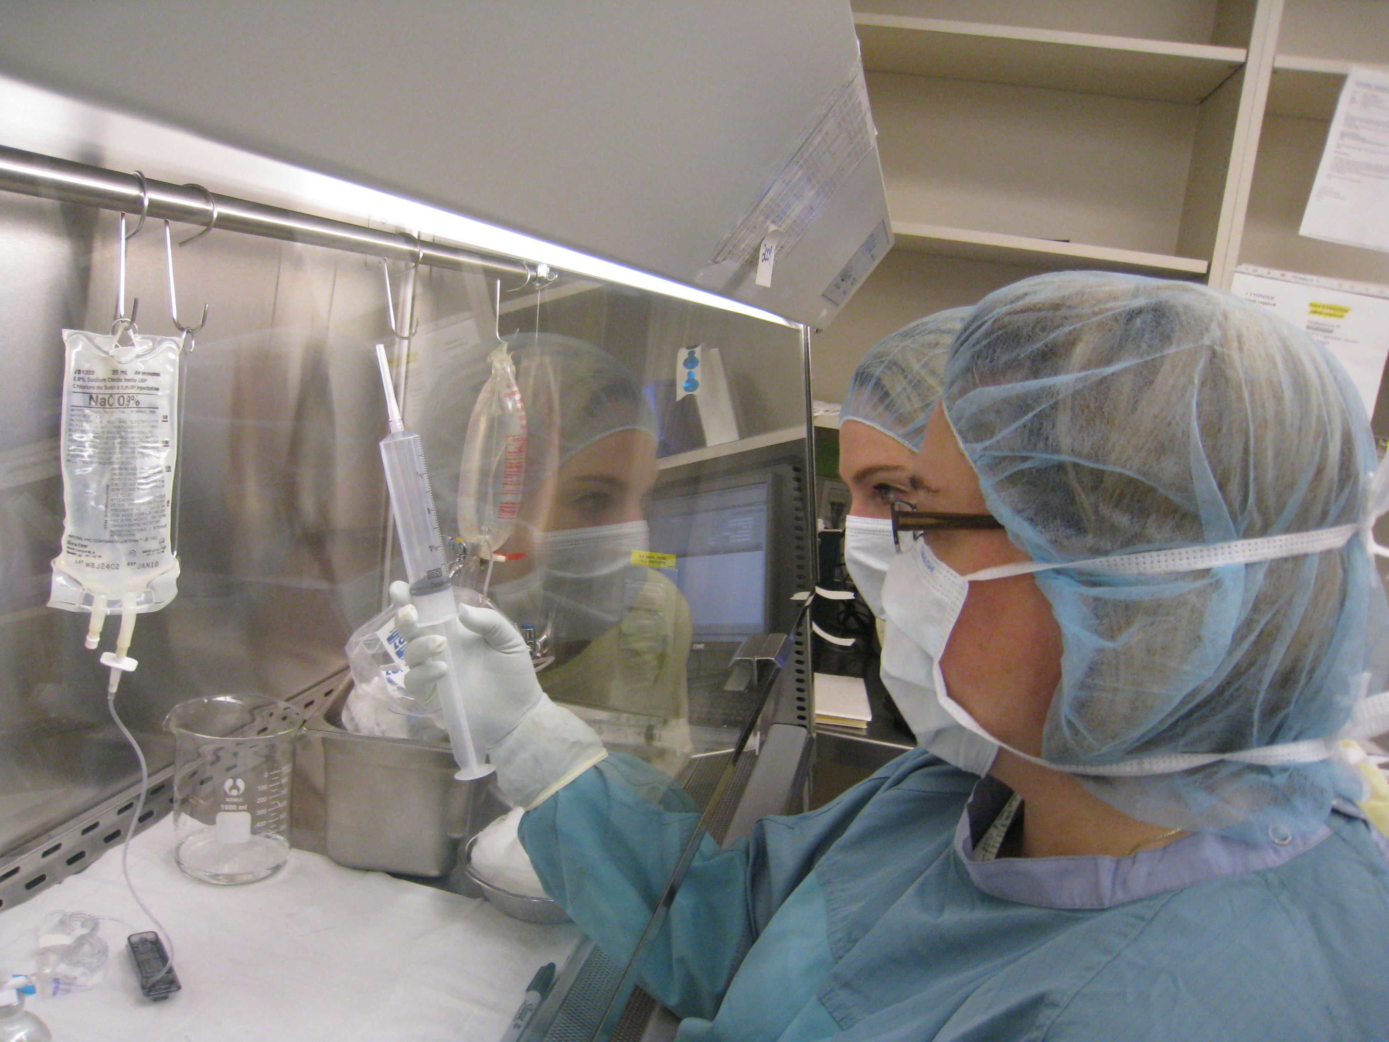

Slide 37
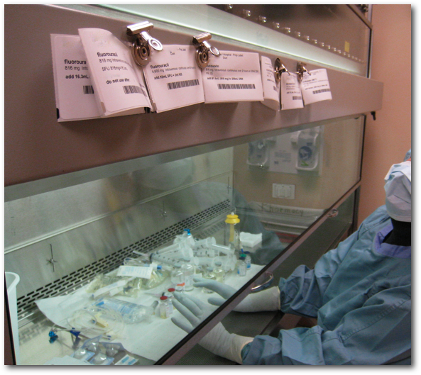
Notes:
Because multiple drugs in BSC at once, could inject wrong drug and show correct vial for check
Because of separation of bags/labels/instructions, could apply label to wrong mixed bag.
Recommendations:
One mix at a time in BSC
Co-location of labels and materials
EFFICIENCY PRESSURE
STERILITY
OUTCOME: Research proposal on

Slide 38

4. Additional issues
Notes:
RACHEL
These issues didn’t jump out at us right away, but after looking at the data for nearly a year, they emerged.

Slide 39
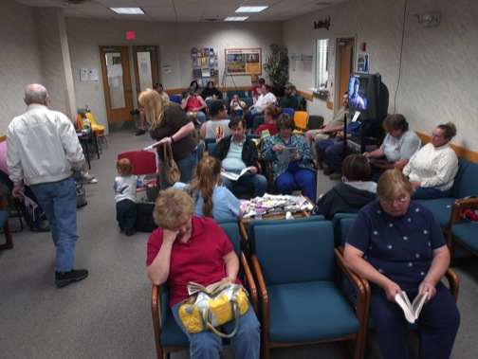
Patient scheduling model
Notes:
RACHEL
We have done intense analysis and believe that for safety.
Complicated issue
Same-day = ordering and treatment take place on same day
Multi-day = treatment takes place on another day, giving pharmacy more time to plan and prepare
Analysis indicates that multi-day = predictable workloads, fewer last-minute changes, and less pressure on staff to work quickly.
Also means more visits for patients, but each one can be shorter, more predictable.
For all centres, accommodation still needs to be made for patients who cannot make multiple visits
BUT WE BELIEVE MULTI DAY IS SOMETHING ALL CENTRES SHOULD STRIVE FOR while being mindful of the complex issues at each centre and for each patient

Slide 40

Simplification and standardization

Slide 41
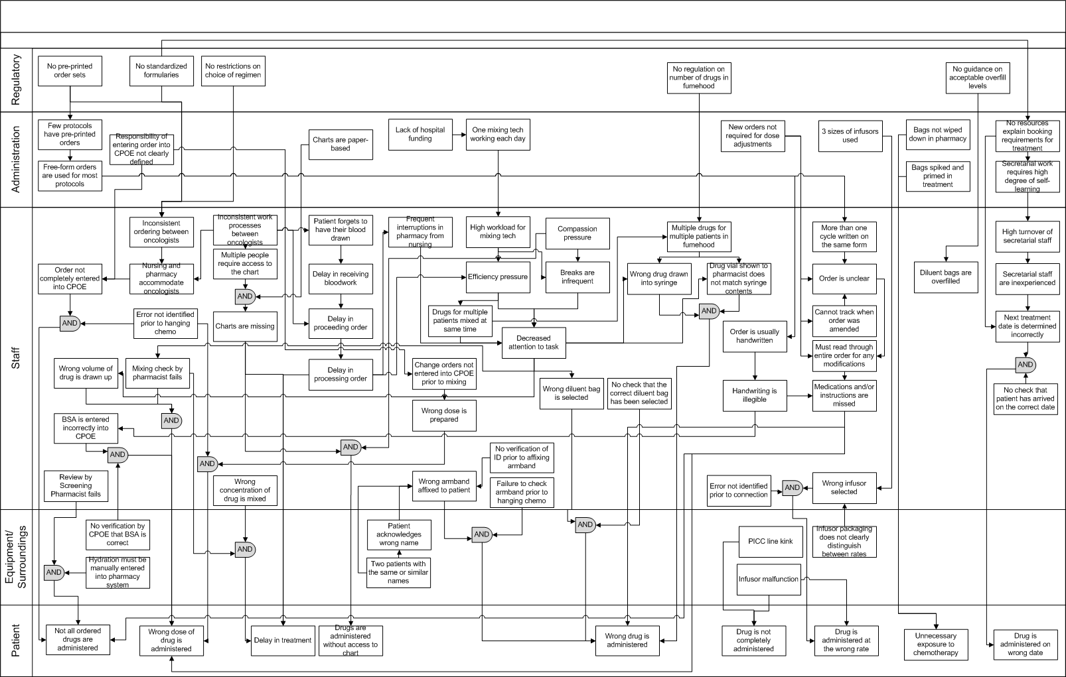
Notes:
RACHEL
Simplification and standardization needs to happen at the highest level of the system. For example, two centres had incredibly confusing processes for moving patients through the system.
One centre had SIX individuals whose sole job was to run charts around and search for missing charts. The issue was with the fact that there was a policy that no photocopying or faxing was allowed. Although this made sense in some ways, it caused chaos in other ways.
Another centre had post it notes in every place you could find, and we could never wrap our heads around what was happening. It turns out each oncologist liked to do things their way, from CrCr formulas to BSA calculations to checking processes.
LOOK BEYOND WHAT IS RIGHT IN FRONT OF YOU
We have a tendency look at band aid solutions rather than upstream solutions

Slide 42

Resources available for download:
http://www.capca.ca/current-issues/patient-safety/research
Final report and recommendations
Preprinted order guidelines
Preprinted order templates (Word and InDesign)
New elastomeric educational materials from Baxter
Notes:
RACHEL
Working with communications experts to disseminate widely across Canada
Probably a press conference…
You should all receive a copy
Please be prepared for practice change
Get involved!

Slide 43

Notes:
Scratching surface of some issues in chemo- more research needed in several areas
Tremendous momentum in oncology community
Awareness that safety issues are much broader than just systemic therapy
PROGRAM IN ONCOLOGY SAFETY?

Slide 44
We cannot change the human condition,
but we can change the conditions under which humans work
James Reason
Notes:
ALWAYS REMEMBER!

Slide 45

Notes:
Questions?

